Slide 1
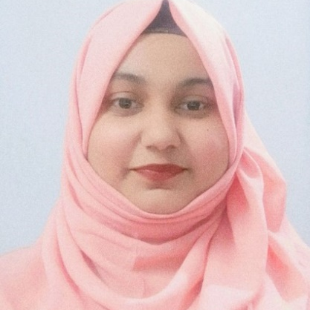


Syeda Shamaila Ayman
Analyst/Software Engineer
Bachelor of Engineering :
2017 - 2021
Skills
Java 8 /J2EE | Java Basics, OOPS, Generics, Collections, Arrays, Loops, Lambda Exp, Stream API Junit, Mockito, Servlets
Spring core | IOC & Dependency Injection, Autowire
Spring REST | REST controllers, Implementation of GET, POST, PUT & DELETE, Bean Validation & Exception Handling, Testing Services, Controller & Repository layer
Spring Data JPA | Implement DAO layer using spring Data repositories
Spring Boot Microservices | Spring Boot Starters, annotations, Messaging Service
.NET | ADO.NET, ASP.NET with MVC5 with Entity Framework
C# | C# Basics, OOPs Concepts, Generics, Collection Framework, LINQ
React | Components, Services, Modules, Routing, Forms & Validation
Database | PostgreSQL, MySQL
UI Tech | HTML 5 & CSS 3,JavaScript
Tools | Git, Postman, Maven, IDE
Add On skills | Peer learning
Chennai
syeda.shamaila-ayman@capgemini.com
+91 8639379943
A4
Full Stack Developer
Hands on experience in creating microservices with Spring boot framework
Full Stack developer with React
Hands on experience in developing web pages using HTML5, CSS3, Object Oriented Java script, JSON, XML. Good understanding of Document Object Model (DOM) and DOM Functions.
Experience in unit testing using JUnit and XUnit.
Online Movie Booking System
Case study of Online Movie Booking System along with API Gateway, responsive UI with HTML5, CSS, Bootstrap and React used as User Interface.
Online Shopping Cart System
Case Study of Online Shopping Cart System using ASP.NET with Entity Framework. MySQL Server as Backend and ASP.NET MVC5 as frontend with HTML,CSS and Bootstrap.
Certifications:
AZ-900 microsoft azure fundamentals
AZ-204 developing solutions for microsoft azure
AWS cloud practitioner
Check out my work on GitHub & Video Profile

